Slide 1
Multiple Object Tracking: A Literature Review
Wenhan Luo, Junliang Xing et al

Slide 2
List
MOT PROBLEM
MOT COMPONENTS
MOT EVALUATION
SUMMARY
Instead of the original order in the paper, Inference is moved from MOT COMPONENTS to
MOT PROBLEM.

Slide 3
MOT PROBLEM
Problem Formulation & Type of Output
Inference Problem Formula
Initialization Method
Processing Mode – online & offline

Slide 4


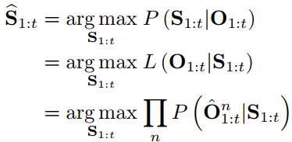
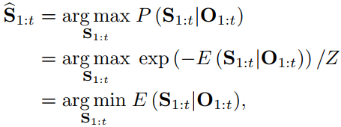
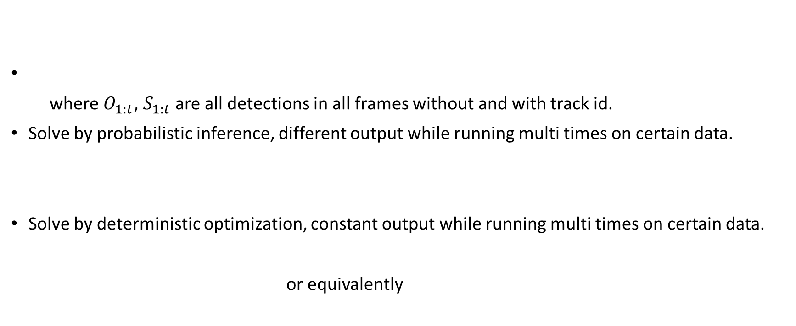
Problem Formulation
where $O_{1:t}$, $S_{1:t}$ are all detections in all frames without and with track id.
Solve by probabilistic inference, different output while running multi times on certain data.
Solve by deterministic optimization, constant output while running multi times on certain data.
or equivalently

Slide 5


Inference. 1
Probabilistic Inference
Represent states of objects as a distribution with uncertainty. The goal of a tracking algorithm is to estimate the probabilistic distribution of target state by a variety of probability reasoning methods based on existing(past and existing) observations. As only the existing observations are employed for estimation, it is naturally to impose the assumption of Markov property in the objects state sequence, that and
Deterministic Optimization
Approaches based on deterministic optimization aim to find the maximum a posteriori (MAP) solution to MOT. To that end, the task of inferring data association, the target states or both, is typically cast as an optimization problem, typically on all the frames or at least a time window. The optimization method can be Bipartite graph matching, Dynamic Programming, Min-cost max-flow network flow, Conditional random field, Maximum-weight independent set. Further detail on these methods in the next page.

Slide 6
Inference. 2
Bipartite graph matching
Two disjoint sets of graph nodes could be existing trajectories and new detections in online tracking or two sets of tracklets in offline tracking. Weights among nodes are modeled as affinities between trajectories and detections. Then either a greedy bipartite assignment algorithm or the optimal Hungarian algorithm are employed to determine the matching between nodes in the two sets.
Dynamic Programming
It’s adopted to solve the association problem among detections or tracklets.
Conditional random field
Defining a graph G = (V, E) where V is the set of nodes and E is the set of edges, low-level tracklets are given as input to the graph. Each node in the graph represents observations or pairs of tracklets , and a label is predicted to indicate which track the observations belongs to or whether to link the tracklets.

Slide 7
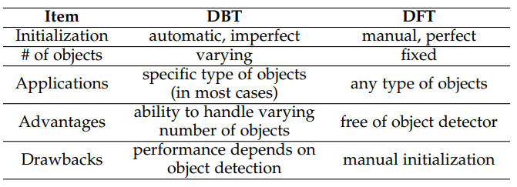
Initialization Method
Detection-Based Tracking(DBT)/ Tracking by detection
Definition: Objects are first detected and then linked into trajectories.
Note: New objects are discovered and disappearing objects are terminated automatically.
Detection-Free Tracking(DFT)
Definition: Requires manual initialization of a fixed number of objects in the first frame, then localizes these objects in subsequent frames.
Note: Can’t deal with the case that objects appear, but free of pre-trained object detectors.
Comparison

Slide 8
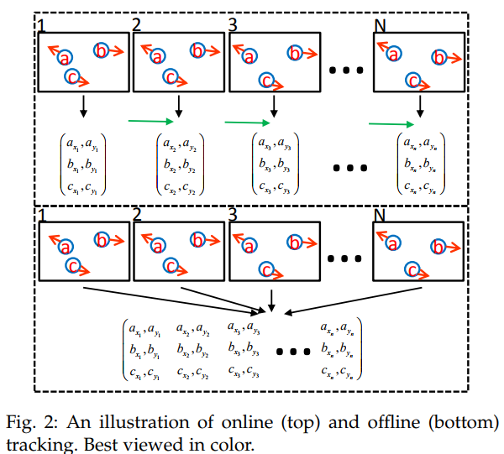
Processing Mode – online & offline
The difference is whether or not observations from future frames are utilized when handling the current frame.

Slide 9
MOT COMPONENTS
Appearance Model
Motion Model & Interaction Model
Exclusion Model
Occlusion Handling

Slide 10

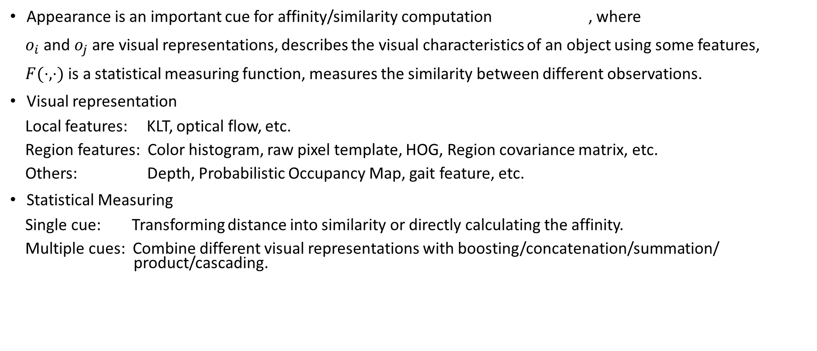
Appearance Model
Appearance is an important cue for affinity/similarity computation , where
$o_{i}$ and $o_{j}$ are visual representations, describes the visual characteristics of an object using some features,
$F(⋅,⋅)$ is a statistical measuring function, measures the similarity between different observations.
Visual representation
Local features: KLT, optical flow, etc.
Region features: Color histogram, raw pixel template, HOG, Region covariance matrix, etc.
Others: Depth, Probabilistic Occupancy Map, gait feature, etc.
Statistical Measuring
Single cue: Transforming distance into similarity or directly calculating the affinity.
Multiple cues: Combine different visual representations with boosting/concatenation/summation/ product/cascading.

Slide 11
Motion Model & Interaction Model(boring)
Motion model
Linear motion model
Non-linear motion model
Interaction model, captures the influence of an object on other objects
Social force models
Targets determine their velocity, acceleration, and destination based on observations of
other objects and the environment.
Crowd motion pattern models
To alleviate the difficulty of tracking an individual object in the over-crowded scenario.

Slide 12
Exclusion Model
Detection-level exclusion
Two different detection responses in the same frame cannot be assigned to the same target
Trajectory-level exclusion
Two trajectories cannot be infinitely close to each other, with penalizing the case that two close detection hypotheses have different trajectory labels.
My: The two exclusions are important because sometimes/usually models do not have the two 100% correct prior.

Slide 13
Occlusion Handling
Occlusion causes ID switches or fragmentation of trajectories.
Part-to-whole, assuming a part of the object is still visible while occlusion, mostly holds true.
Affinities regarding occluded parts should be low, where a popular way is dividing a holistic object into several parts by grid or fitting(e.g head, upper body, … for person) and computing affinity based on individual parts.
Hypothesize-and-test
Make hypothesis as prior, then test whether the hypothesis hold true.
Buffer-and-recover
Buffers observations while occlusion and remembers states of objects before occlusion. When occlusion ends, object states are recovered based on the buffered observations and the stored states before occlusion. My: you need to inference the trajectory while occlusion.
Others
For example, targets as Gaussian distributions in image space and explicitly model pair-wise occlusion ratios between all targets as part of a differentiable energy function.

Slide 14
MOT EVALUTION
Metrics
Datasets
Public Algorithms
Benchmark Results

Slide 15
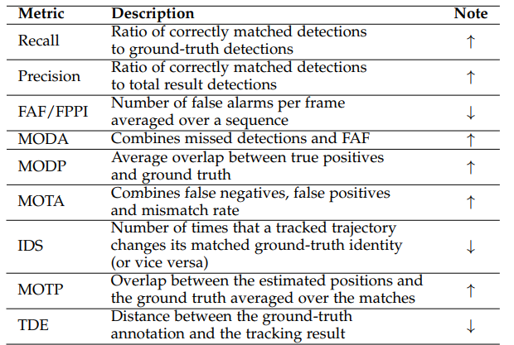
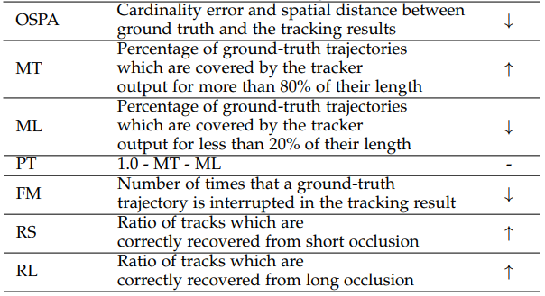
Metrics
Up arrow (resp. down arrow): better if the quantity is greater (resp. smaller).

Slide 16
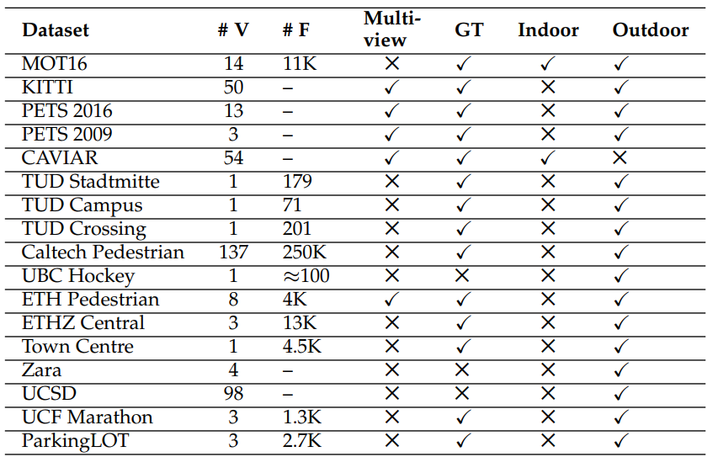
Datasets
where
#V: video numbers
#F: frame numbers
GT：groundtruth
Problems:
The scale of datasets for MOT is relatively smaller than single object tracking.
(Most) current datasets focus on pedestrians.

Slide 17
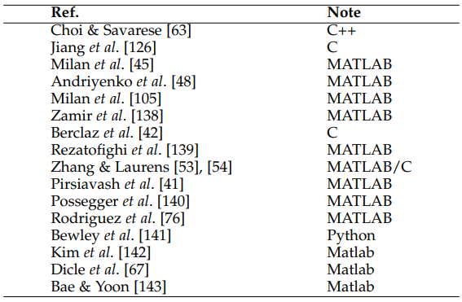
Public Algorithms
Codes are public, please see the reference.

Slide 18
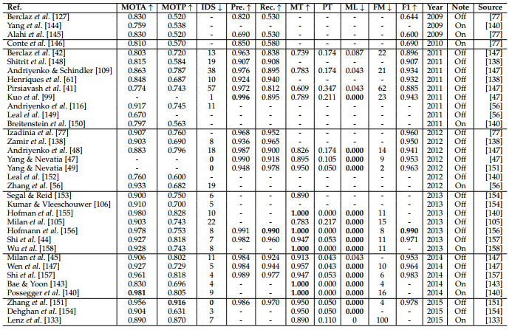
Benchmark Results
Result on PETS2009-S2L1. See the original paper for better view.

Slide 19
SUMMARY
Existing Issues
Future directions

Slide 20
Existing Issues
Dataset:
The scale of datasets for MOT is relatively smaller than single object tracking.
(Most) current datasets focus on pedestrians.
Most codes are not public.
Performance depends heavily on the object detectors. Changing detector affect performance heavily. My: You can see [1].
More complicated algorithm, more parameters to fit.
Many methods overfits specific sequence with bad generalization.
[1] poi: multiple object tracking with high performance detection and appearance feature

Slide 21
Future Directions
MOT with video adaptation
The majority of current MOT methods requires an offline trained object detector. The detection result for a specific video is not optimal for the test video. (I think YOLO has good generalization.)
MOT under multiple cameras
Multiple 3D object tracking
MOT with scene understanding
MOT with deep learning
MOT with other computer vision tasks
Possible combinations include object segmentation, human re-identification, human pose estimation , and action recognition.
Extend targets to other objects instead of pedestrians.

